Slide 1


Intracranial Hemorrhage Detection
Jacob Padden, Nithin Saseendran, Danyang Zhang, Kelly Zhang, Sichun Zuo

Slide 2
A
GENDA
01 |
BACKGROUND & MOTIVATION
02 |
EDA
02 |
DATA PRE-PROCESSING
04 |
MODEL
05 |
MODEL EXPLANABILITY
06 |
FUTURE WORK

Slide 3
P
art 01
Background &
Motivation

Slide 4


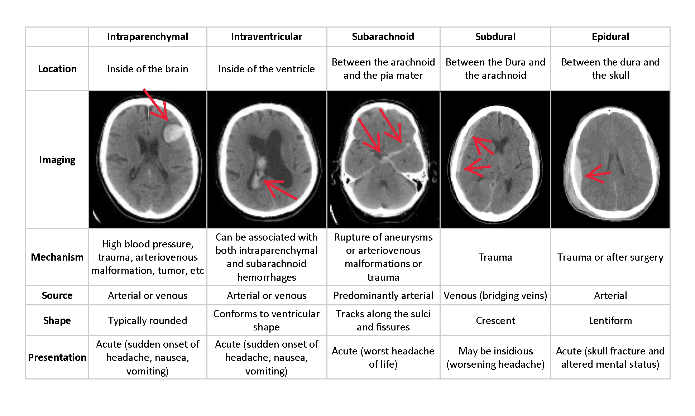
What is Intracranial Hemorrhage
Intracranial hemorrhage (ICH) refers to bleeding inside the skull or brain.
Accounts for approximately 10% of strokes in the U.S., where stroke is the fifth-leading cause of death.
Depending upon the size, type, and location of the blood
Notes:
Intracranial Hemorrhage refers to acute bleeding inside the skull or brain. There are many subtype of hemorrhage, it depends on the size/type/location of the blood in the crinum
In our data we have 5 different subtypes, and you can see, the white space that the arrows are pointing to, are the blood.
Depending on the subtype the result can range from server headaches to death.

Slide 5
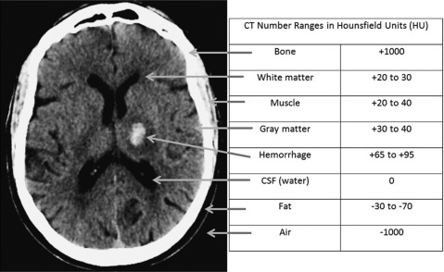

Motivation
2
Eye can detect only 6% change in grey scale
Tissue have to very their density by at least 120 HU to detect density difference
Notes:
When a patient shows symptoms such as severe headache or loss of consciousness, specialists review medical images of the patient’s to look for the type of hemorrhage
Diagnosis requires urgent procedure, However for our human eyes to detect a difference there has to a 120 HU unit difference.

Slide 6
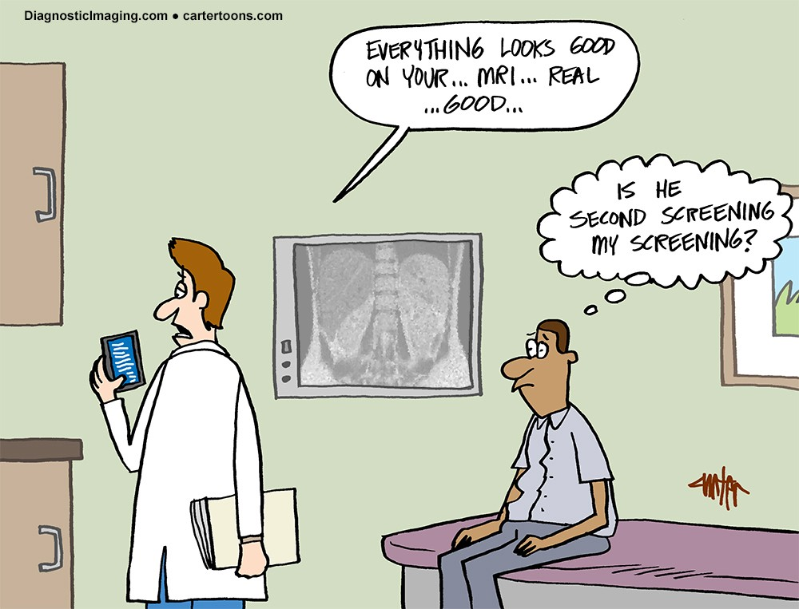
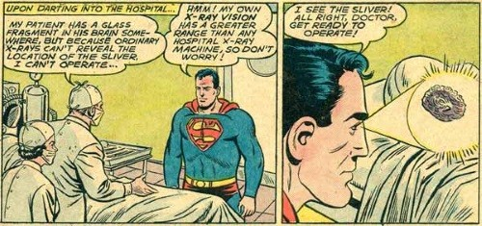
Motivation
Hemorrhage in the brain shows relevant HUs in the range of 8-70
In a pre-deep learning era...
Help Doctors make faster and more accurate diagnoses
Notes:
But the Hemorrhage in brain shows relevant HUs in the range of 8-70.
making the process complicated and time consuming.
before deep-learning era, we will have to
by introducing deep learning we can develop algorithms that can give efficient and accurate diagnose

Slide 7
P
art 02
EDA

Slide 8
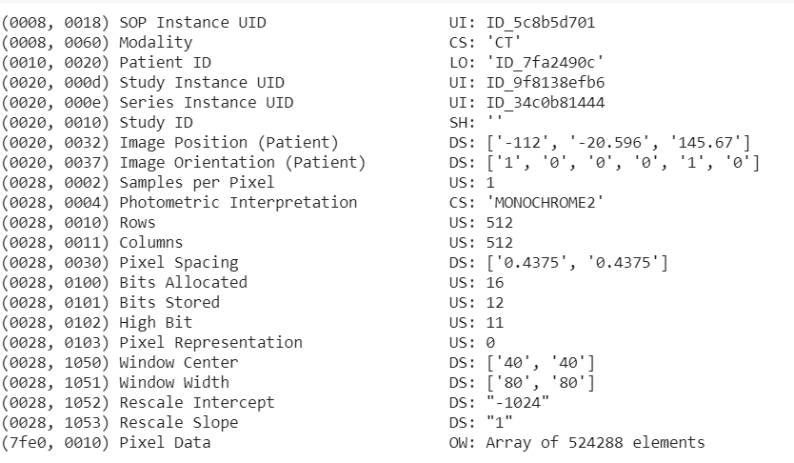
Data
ID | Label
ID_5c8b5d701_epidural | 1
ID_5c8b5d701_intraparenchymal | 0
ID_5c8b5d701_intraventricular | 0
ID_5c8b5d701_subarachnoid | 0
ID_5c8b5d701_subdural | 0
ID_5c8b5d701_any | 1
DICOM
Notes:
We got our Data from Kaggle. DICOM and CSV file with labels.
DICOM commonly used for storing and transmitting medical images
From the metadata in the DICOM file we get the SOP Instance UID that matches ID to the label CSV file. The images are pixel values of 512*512.
because our images are still in raw pixels these metadata such as windowing information,pixel intercept are very important when we pre-processed the data.

Slide 9
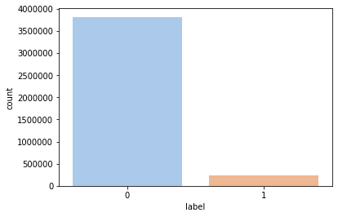
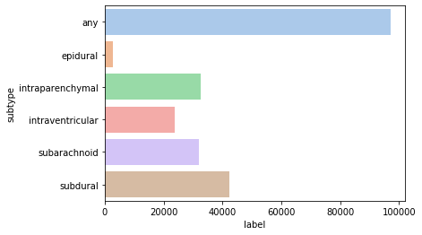
Data
94 %
Notes:
One thing to note, is that we have a very imbalance data. 94% of our data are negative class.
Also,among the positive class the distribution of the subtypes are not balanced.
Our goal is to detect whether there are any Hemorrhage and what is the type of the Hemorrhage.
So we sample our data to be representative of each class. Now we have about 20 G of data to work on colab.

Slide 10
P
art 03
Data Preprocessing

Slide 11
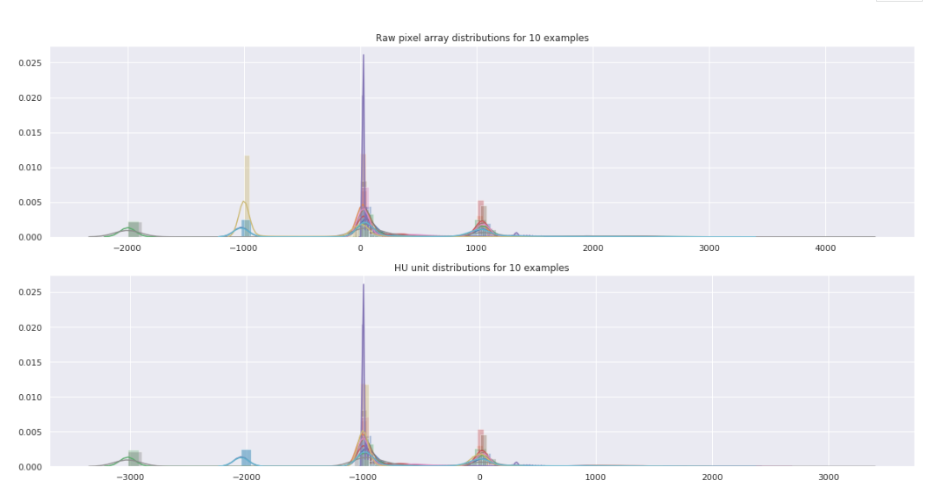
Scaling
Notes:
Our Data contains 5 different kinds of Intracranial Hemorrhage. And a CSV with labels.
The Hounsfield scale is a quantitative scale for describing radiodensity. It is frequently used in CT scans, where its value is also termed CT number.

Slide 12
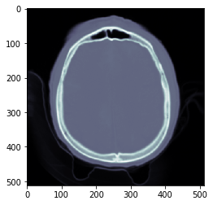
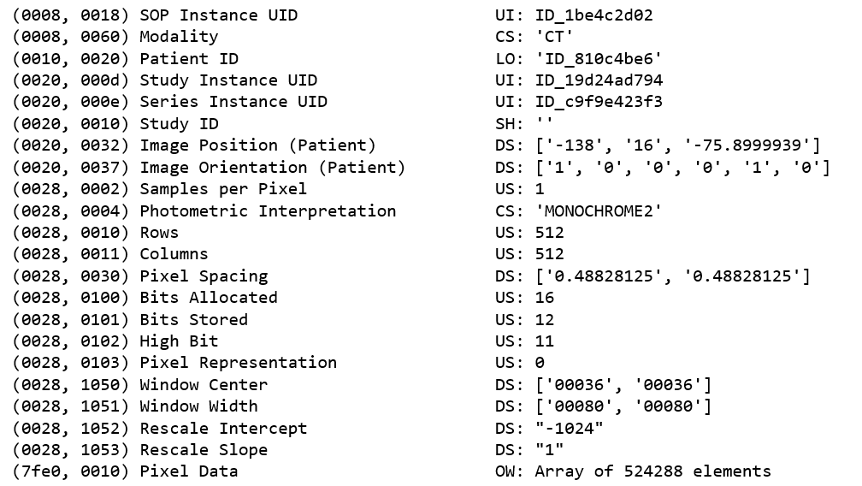
Scaling
No Windowing
img = img.pixel_array * img.RescaleSlope + img.RescaleIntercept

Slide 13
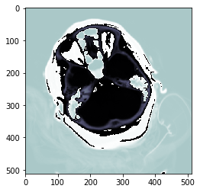
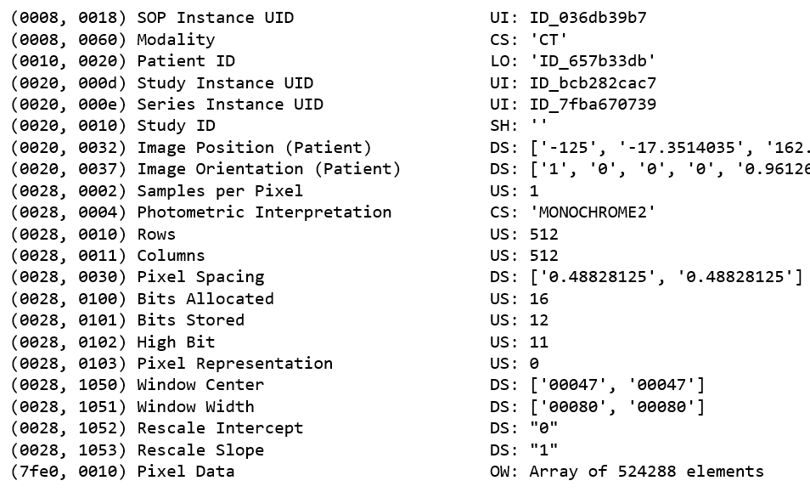
Scaling
No Windowing

Slide 14
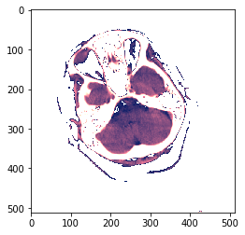
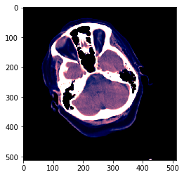
img = img.pixel_array * img.RescaleSlope + img.RescaleIntercept
Original
RescaleIntercept = 0
RescaleIntercept = -1000

Slide 15
Window
Basic
First Transform
Subdural
Brain
Soft

Slide 16
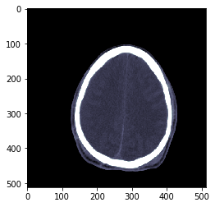
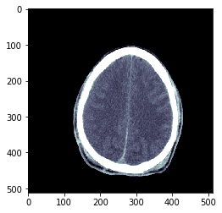
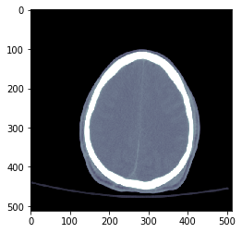
First Transform
Metadata
Subdural
Brain
Soft

Slide 17
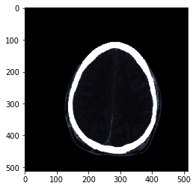
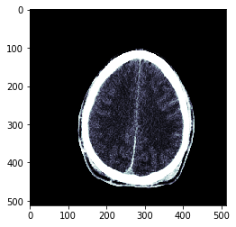
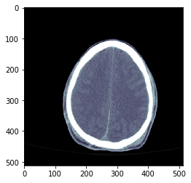
First Transform
Sigmoid
Subdural
Brain
Soft

Slide 18
Basic
Basic
First Transform
Subdural
Brain
Soft
Second Transform
Soft
Brain
Subdural

Slide 19
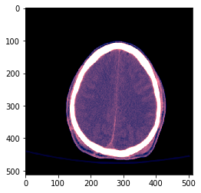
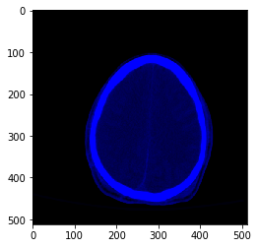
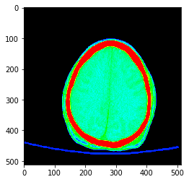
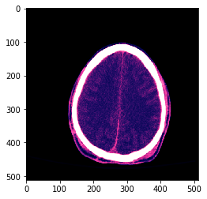
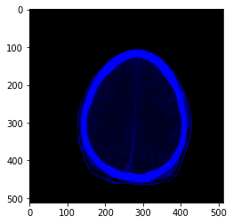
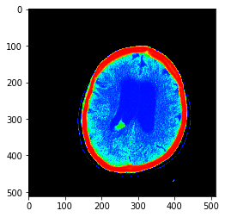
Second Transform
Metadata
Stack Layers
Three Channels
Gradient
Sigmoid

Slide 20
P
art 04
Modeling

Slide 21
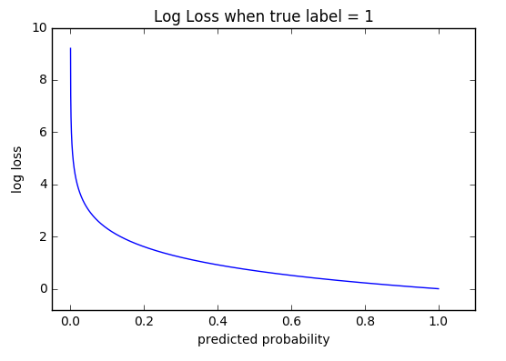
Model Evaluation
Metric: Weighted Log Loss
Weights: 2/7 for ‘any’ hemorrhage
1/7 for all sub-types
Notes:
Before we move into the modeling part, we defined our own loss function to evaluate the model. we used weighted log loss and the weight for the prediction ‘any’ is twice over the weight for the predictions of all other sub-types. In this way, we attached more importance to the detection of any type of hemorrhage than detecting the sub-types.

Slide 22
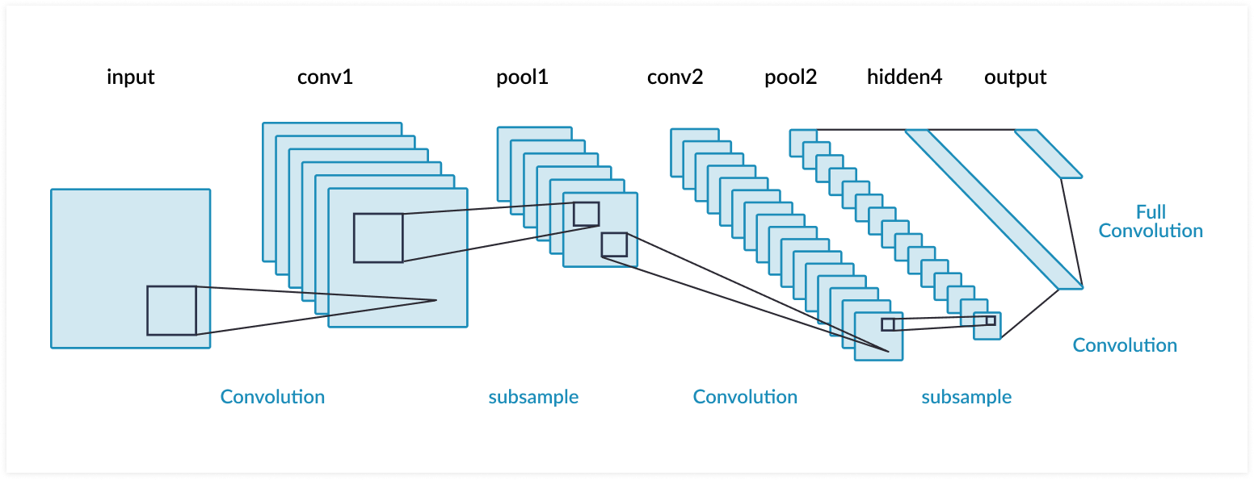
CNN from scratch
CNN Architecture
input image shape: 128*128*3
3 Convolutional Layers:
32, 64, 128 filters with size 3*3,
padding,
LeakyReLU as activation
3 Max Pooling Layers: filter size 2*2
1 Fully Connected Layer
1 Output layer with sigmoid as activation function
Data augmentation (for now)
Randomly flip inputs horizontally
random rotations
Training
32 mini batches
20 epochs
adam
Notes:
for computational purposes, we converted the size of input image o 128 by 128 by 3.
we have 3 convolutional layers, 3 max pooling layers and 1 fully connected layer.
For the convolution layers, as the network gets deeper, we used more filters enable to detect more features. The size of the filter is 3*3. we also used padding so that output size is the same as input size. For the activation function, we used LeakyReLu, the derivative of the LeakyReLU is 1 in the positive part, and is a small fraction in the negative part. So it will always have a little slope to allow the gradients to flow on. We also added 1 max pooling layer after each convolutional layer.
we also used data augmentation methods such as flipping and random rotation to generate more data and train a more robust model.
we train the model on 32 mini batches for 20 epochs.

Slide 23
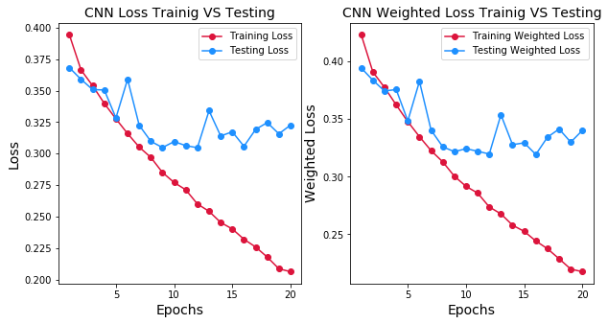
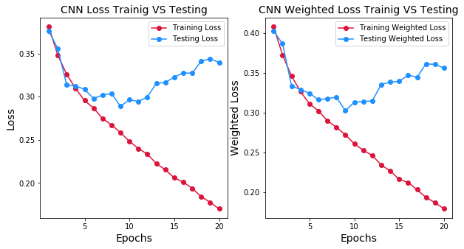
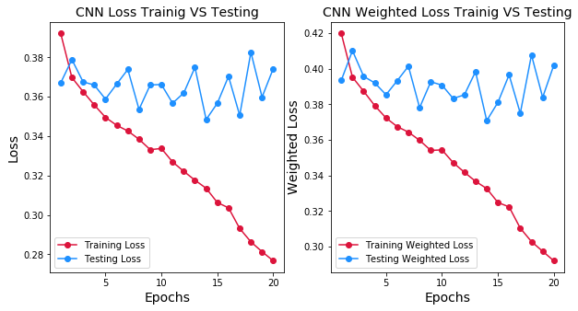
weighted log Loss Training vs. Validation
metadata
metadata + gradient
metadata + 3 channels
Notes:
we tried 3 windowing methods as candice mentioned before and each gave us the weighted loss. metadata together with gradient performed the best and the weighted loss on the validation set hit 0.3. all the methods have overfitting problems for now after 5 epochs

Slide 24

What Next?
Notes:
We need better performance without taking much time and like everyone, we go for transfer learning...import keras.
Instead of trying different pre-trained models, we decided to go with just one and then tune them. We selected Inception V3 as they are known to provide better results.

Slide 25
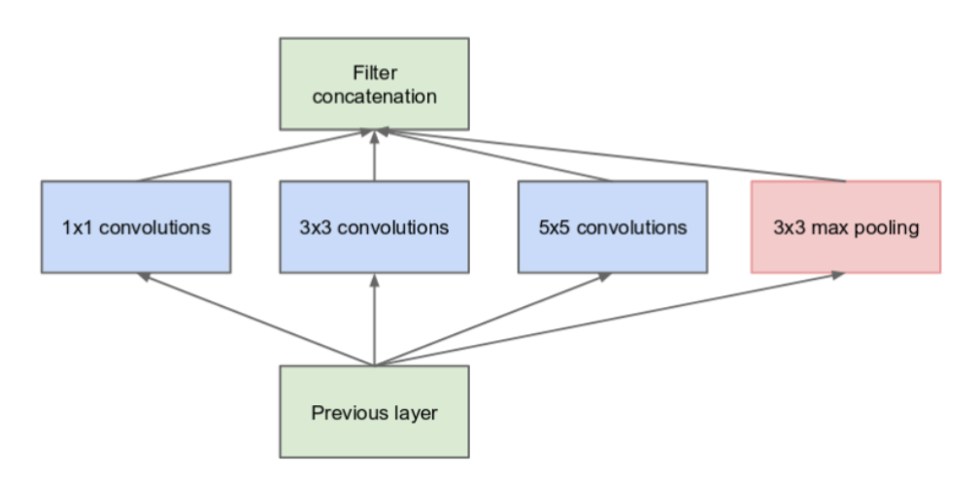
Inception Architecture
Huge variation in the location of the information -> need to choose right kernel size for the convolution operation
Filters with multiple sizes operate on the same level
Performs convolution on an input, with 3 different sizes of filters (1x1, 3x3, 5x5). Additionally, max pooling is also performed. The outputs are concatenated and sent to the next inception module.
Inception Module - Naive Version
Notes:
Before inception architecture came into being, popular CNNs just stacked convolutional layers deeper and deeper, hoping to get better performance. The Inception network on the other hand, was complex and used a lot of tricks to push performance. So, the premise where it all started was,.......
Naively stacking large convolution operations is computationally expensive. Why not have filters with multiple sizes operate on the same level? The network essentially would get a bit “wider” rather than “deeper”.
Vanishing gradient problem is a difficulty found in training artificial neural networks with gradient-based learning methods and backpropagation. In such methods, each of the neural network weights receives an update proportional to the partial derivative of the error function with respect to the current weight in each iteration of training. The problem is that in some cases, the gradient will be vanishingly small, effectively preventing the weight from changing its value. In the worst case, this may completely stop the neural network from further training.

Slide 26
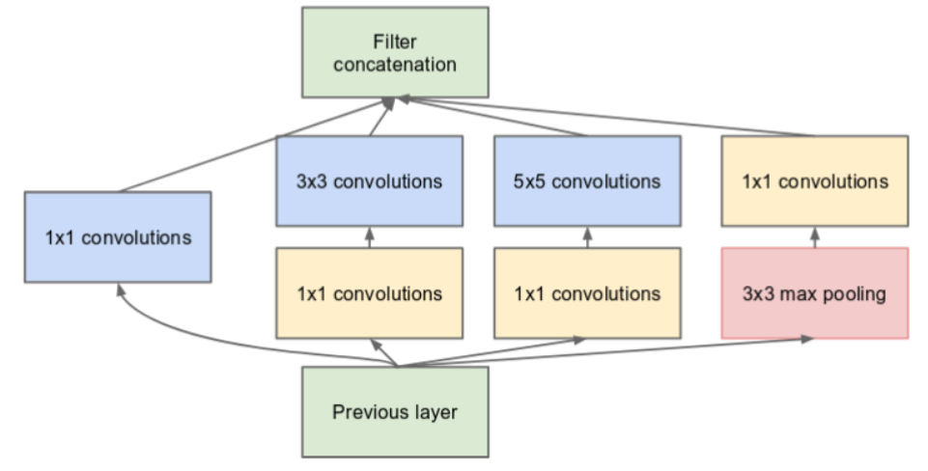
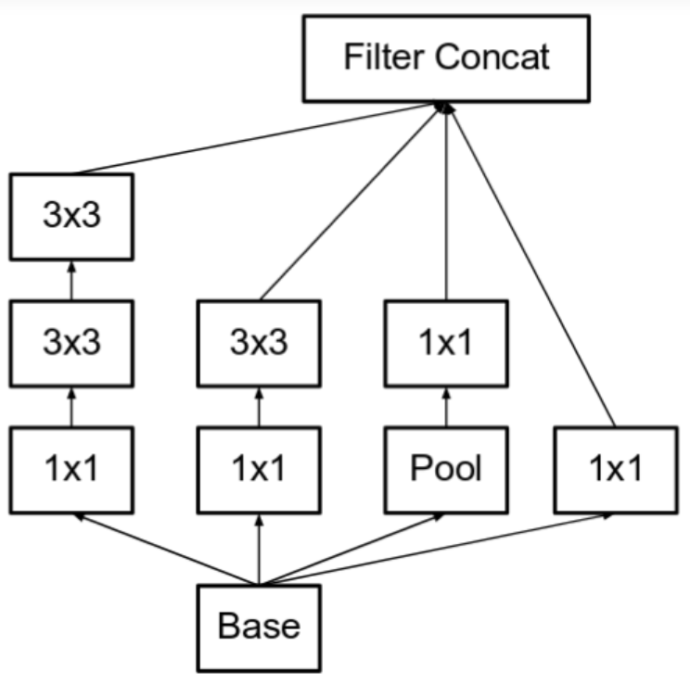
Inception Architecture
Inception V1 - using the Using the dimension reduced inception module. Extra 1x1 convolution to reduce dimension. Two auxiliary classifiers
Factorize 5x5 convolution to two 3x3 convolution Improved computational speed. Further factorize convolutions of filter size nxn to a combination of 1xn and nx1 convolutions.
Notes:
To reduce computation further, dimensionality reduction and having 2 auxiliary classifiers (To prevent the middle part of the network from “dying out”)
auxiliary classifiers, where small CNNs were inserted in between layers for training time, and the loss from these auxiliary classifiers were added to the main classification loss. The total loss function is a weighted sum of the auxiliary loss and the real loss. Weight value used in the paper was 0.3 for each auxiliary loss.
Example, a 3x3 convolution is equivalent to first performing a 1x3 convolution, and then performing a 3x1 convolution on its output. They found this method to be 33% more cheaper than the single 3x3 convolution.

Slide 27
Inception V3
Factorized 7x7 convolutions
BatchNorm in the Auxiliary Classifiers - technique for training very deep neural networks that standardizes the inputs to a layer for each mini-batch.
Label Smoothing - Type of regularizing component added to the loss formula that prevents the network from becoming too confident about a class. Prevents overfitting.
Bach Size: 32
Learning Rate: 5e-4
Optimizer: Adam
Evaluation Metric: Weighted Log Loss
# of Epochs: 10
Notes:
auxiliary classifiers, where small CNNs were inserted in between layers for training time, and the loss from these auxiliary classifiers were added to the main classification loss. The total loss function is a weighted sum of the auxiliary loss and the real loss. Weight value used in the paper was 0.3 for each auxiliary loss.

Slide 28
Model Evaluation
CNN
Weighted Log Loss (Validation) : ~0.3
Inception V3
Weighted Log Loss (Validation) : 0.0618
Weighted Log Loss (Test) : 0.2715
Notes:
Test loss is not that impressive, but given that we trained on a smaller dataset on Colab, this is good enough and can improve further by employing ensemble methods.
Once Deep learning models were built, we were trying to explain these models and found out it is more difficult to explain than build one. Calling Jacob to explain the explainability part of the model.

Slide 29
P
art 05
Model Explanability

Slide 30
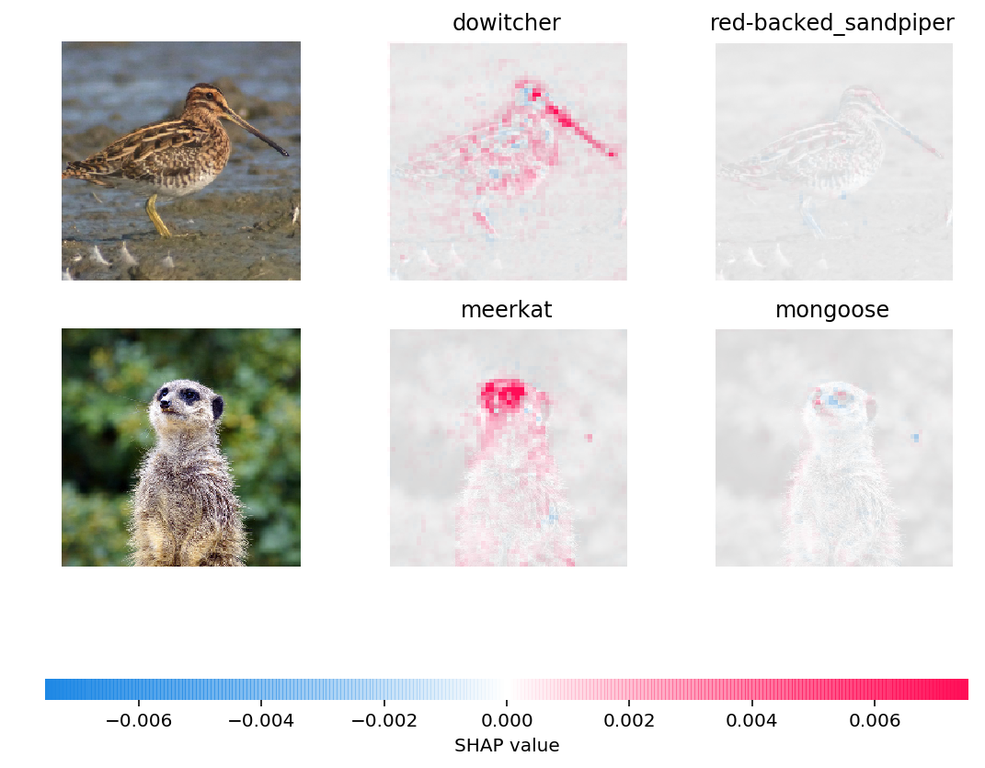
Leveraging Shapley Values
Quantifies prediction contribution of each feature (pixel)
Rooted in game theory
Analyzes predictions of all subsets of features and compares prediction power with and without feature at hand
Computation grows exponentially with number of features

Slide 31
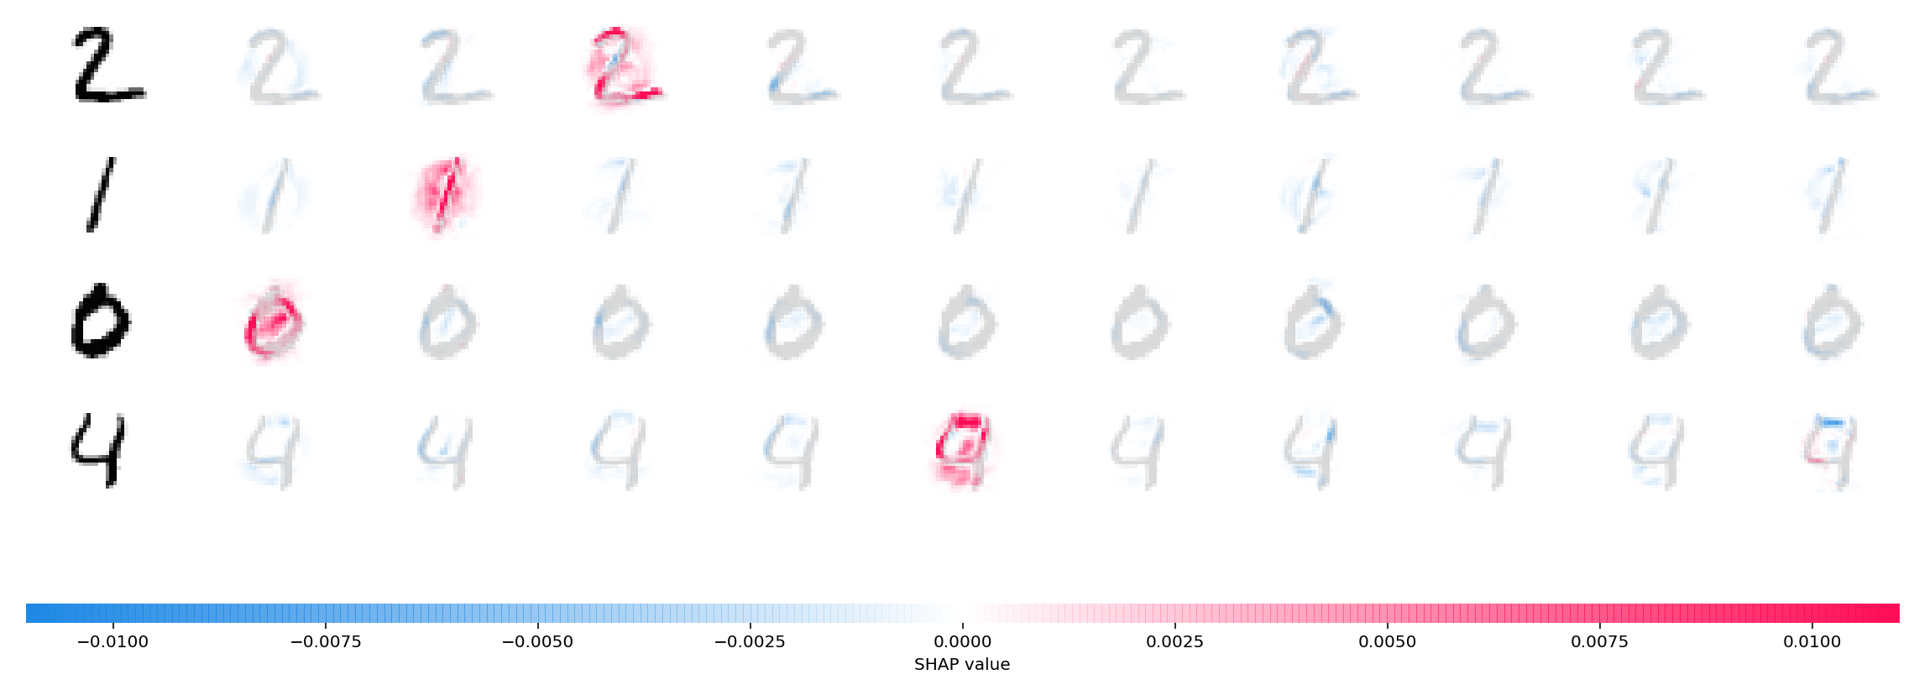
Leveraging Shapley Values

Slide 32
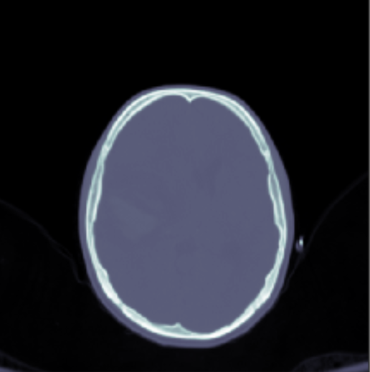
Vizualizing Hemmorrhage Classification
Show same image under context of different classificaitions
Intraparenchymal
Intraventricular

Slide 33
P
art 04
Future Work

Slide 34
Future
Work
Train models on entire dataset
Avoid overfitting of cnn model
early stopping
dropout layer
…
Package into application for use by doctors

Slide 35
THANK YOU
ANY QUESTIONS?

